Slide 1
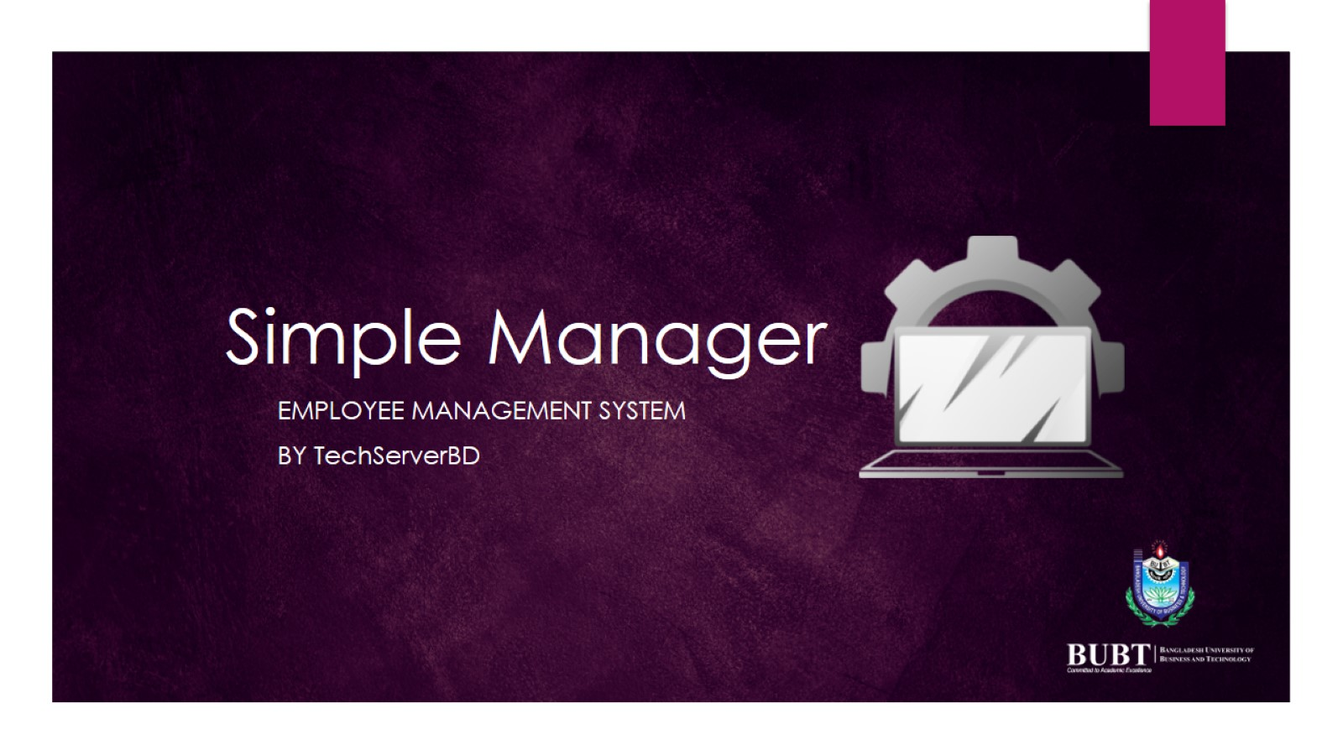
Simple Manager

Slide 2
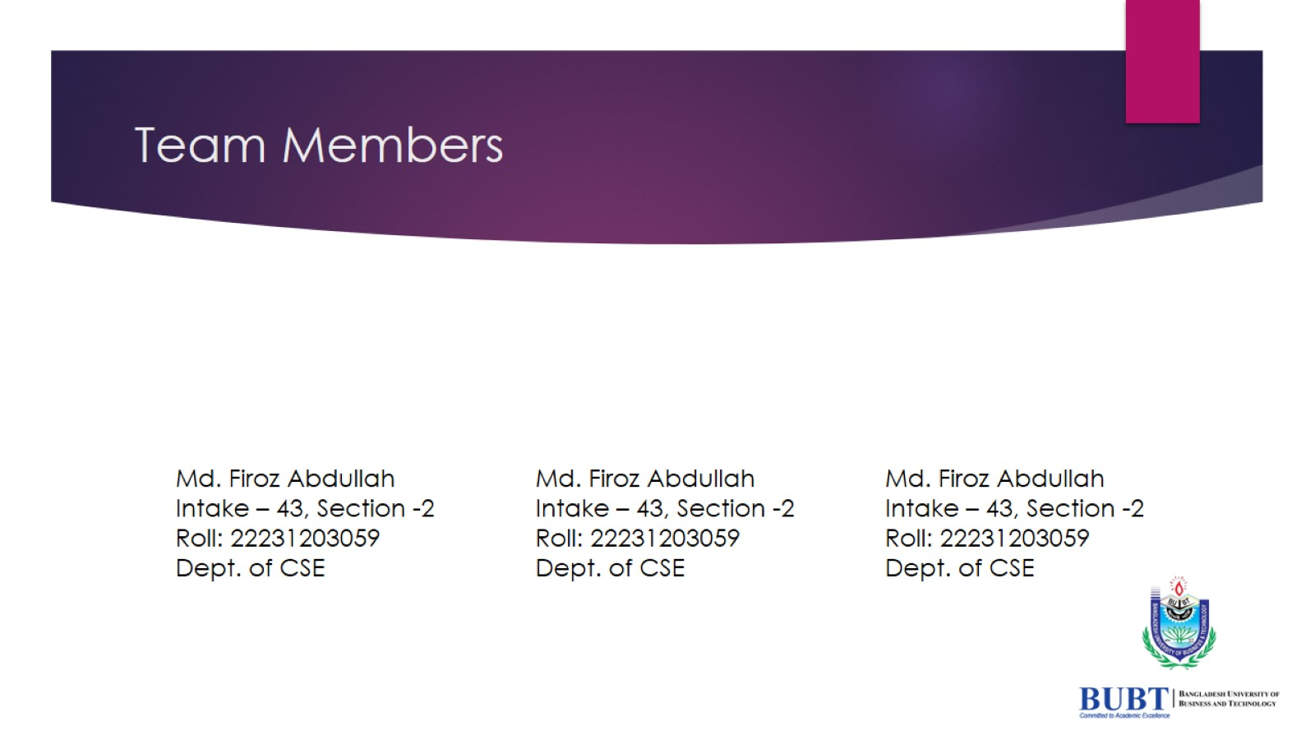
Team Members

Slide 3

What is Employee Management System?

Slide 4
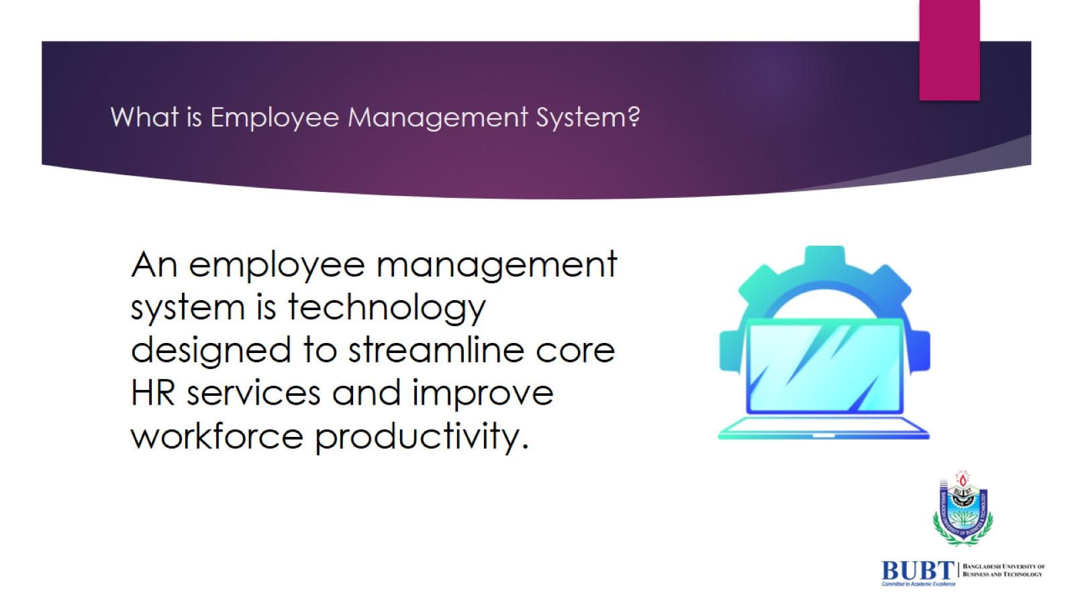
What is Employee Management System?

Slide 5

Benefits of An Employee management System

Slide 6
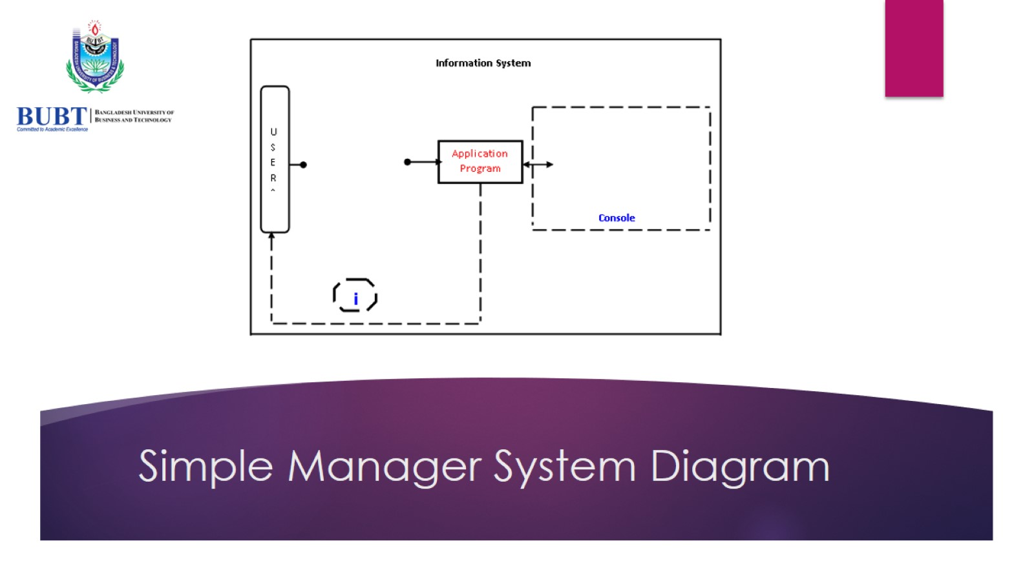
Simple Manager System Diagram

Slide 7
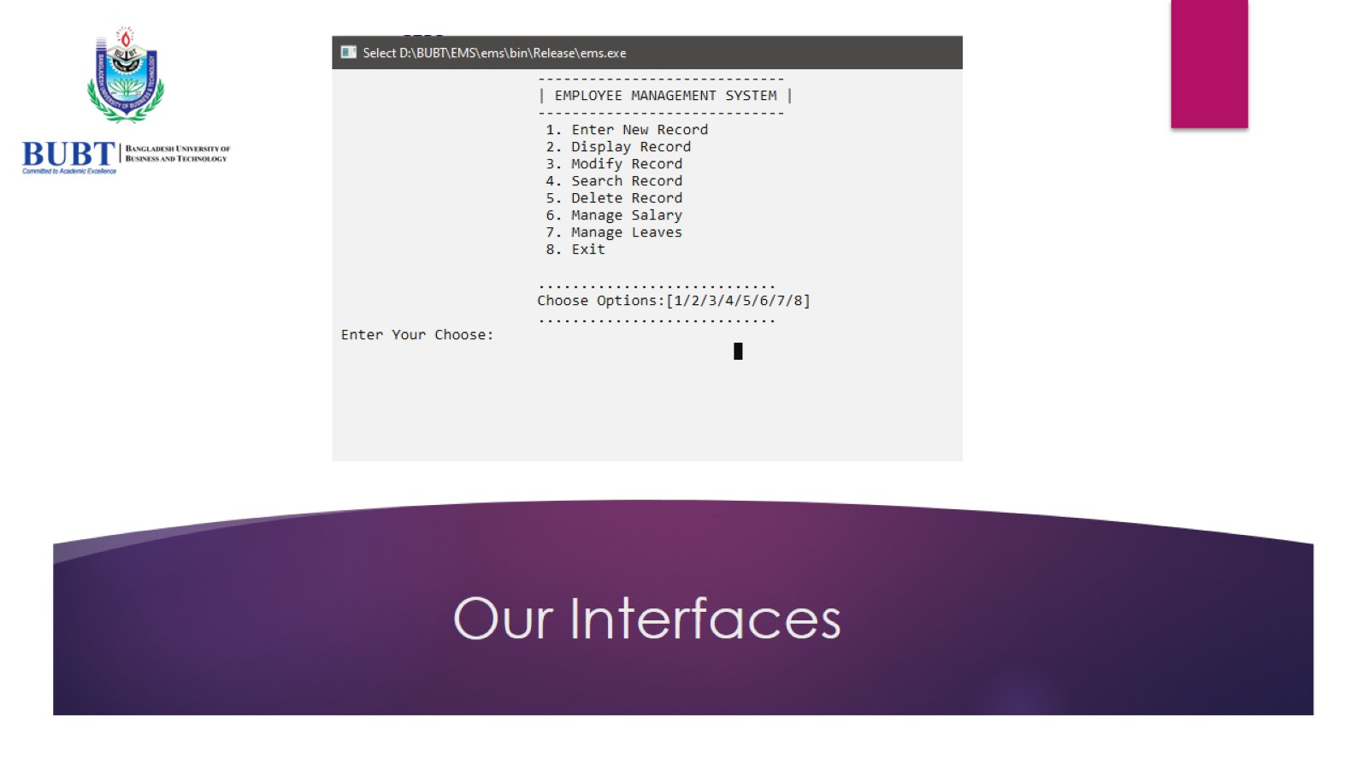

Slide 8
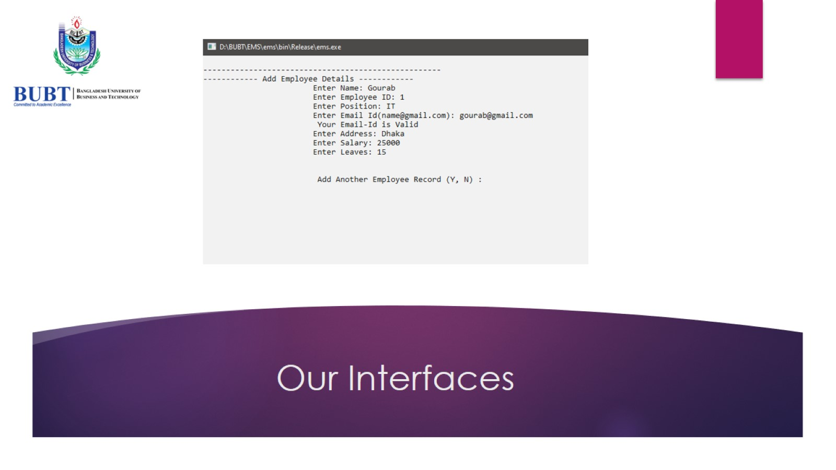

Slide 9


Slide 10


Slide 11

Challenges

Slide 12

Future Updates

Slide 13

Thank you

